Slide 1
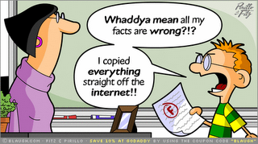

Slide 2
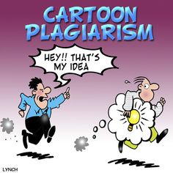

Slide 3
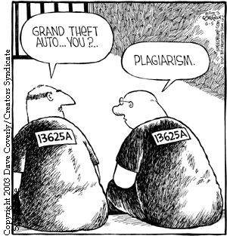

Slide 4
PARAPHRASING
-PUTTING INFORMATION IN YOUR OWN WORDS
-USED IN RESEARCH AND EXPOSITORY WRITING

Slide 5
Why Paraphrase?
So YOUR voice comes through in your writing
In research, most of your writing should be paraphrased
Only use 1 or 2 short direct quotes

Slide 6
Why Paraphrase?
So you don’t plagiarize!
In research, most of your writing should be paraphrased
Only use 1 or 2 short direct quotes

Slide 7
What do you do first before you can paraphrase something?
Read it!
What is the second thing you have to do before you can paraphrase something?
Unfortunately, you can’t paraphrase something you don’t understand! So if you understand it, you are good to go, but what happens when we don’t understand something? Reread it sentence by sentence.
Notes:
Let students share and then random sample to report their conversations.

Slide 8
Eating breakfast actually helps you in school because it helps your brain work better. School children who eat breakfast have several advantages: having more energy, paying more attention inside the classroom, and even earning higher grades in their courses.
Shows all meaning
Doesn’t add to or change meaning
In your own words
EXAMPLES
Eating breakfast improves how your brain works which helps you learn
Your brain works better when you eat breakfast, helping you in school.
Eating breakfast helps your brain function more and you’ll do better in school.
Notes:
random sample responses

Slide 9
PARAPHRASE: TO PUT INFORMATION INTO YOUR OWN WORDS 1. Rewrite these sentences in your own words. 2. Be sure your new sentences have the same meaning. 3. Work with your group. You may use a dictionary or Word Central (wordcentral.com) if necessary.

Slide 10
Niagara Falls is viewed by thousands of tourists every year.
Each year, thousands of people visit Niagara Falls.

Slide 11
The still waters of the Caribbean were teal in color.
The turquoise Caribbean waters were calm.

Slide 12
Symptoms of the flu include fever and nasal congestion.
Stuffiness and a rising temperature are signs of the flu.

Slide 13
Steve Jobs co-founded Apple Computers with Steve Wozniak. Under Jobs' guidance the company pioneered a series of revolutionary technologies including the iPhone and iPad.
The iPhone and iPad are a part of the groundbreaking Apple innovations
from Steve Jobs. Jobs started Apple with Steve Wozniak.

Slide 14
By current scientific reckoning, our planet is 4.54 billion years old, give or take a few million years.
What?
What about it?
Who says?

Slide 15
By current scientific reckoning, our planet is 4.54 billion years old, give or take a few million years.
Paraphrased:
Scientists say the earth is about 4 1/2 billion years old.

Slide 16
To paraphrase longer passages: -read it a couple times. -be sure you understand it -try to put it in your own words WITHOUT looking back at the text (if you have to look back, chunk it).

Slide 17
When World War I started Marie Curie learned that doctors could use X-rays to help determine what was wrong with an injured soldier. However, there weren't enough X-ray machines for every hospital to have one. She came up with the idea that the X-ray machines could move from hospital to hospital in a truck. Curie even helped to train people to run the machines. The trucks became known as petites Curies, meaning "little Curies" and are thought to have helped over 1 million soldiers during the war.

Slide 18
When World War I started Marie Curie learned that doctors could use X-rays to help determine what was wrong with an injured soldier. However, there weren't enough X-ray machines for every hospital to have one. She came up with the idea that the X-ray machines could move from hospital to hospital in a truck. Curie even helped to train people to run the machines. The trucks became known as petites Curies, meaning "little Curies" and are thought to have helped over 1 million soldiers during the war.

Slide 19
During WWI Marie Curie discovered that doctors needed X-Ray machines to help wounded soldiers. She developed a mobile unit that could travel to the different hospitals because there weren’t enough around. She also instructed people on how to use them. These travelling units became called “little Curies” after Marie and probably saved many soldiers’ lives.

Slide 20
The Attack on Pearl Harbor happened on December 7th, 1941. Japanese airplanes made a surprise attack on the US Navy in Pearl Harbor. Pearl Harbor is located in Hawaii on the island of Oahu. During the time of World War II, Hawaii was not a state, but a US territory. Japanese fighter planes and bombers destroyed many ships and killed many American soldiers. It was this attack that forced the United States to enter World War II.

Slide 21
On December 7th, 1941, Japan unexpectedly attacked the Pearl Harbor naval base in Oahu, Hawaii. Many U.S. soldiers died and numerous ships were destroyed by swarming Japanese military planes. This startling attack on an American territory (Hawaii wasn’t a state yet) propelled the United States into WWII.

Slide 22
1. In the metropolis the recreational area was dilapidated.

Slide 23
2. The educator removed the unruly student from the environment.

Slide 24
3. The crimson automobile accelerated past the concealed law enforcement officer.

